Slide 2
World Suicide Prevention Day: Thinking Globally, Acting Locally
Overview of the National Strategy for Suicide Prevention
In-Person Seminar and Live Webcast
Wednesday, September 4, 2013
9:00 AM – 12:00 noon EST
Dennis O. Romero, MA
SAMHSA Regional Administrator
Region II (NJ, NY, PR & USVI)
Notes:
Concluding comments:

Slide 3
Staggering Reality
~ 36,000 Americans die by suicide each year
Notes:
Suicide is a serious public health problem that causes immeasurable pain, suffering, and loss to individuals, families, and communities nationwide.
For every person who dies by suicide, more than 30 others attempt suicide. Every suicide attempt and death affects countless other individuals. Family members, friends, coworkers, and others in the community all suffer the long-lasting consequences of suicidal behaviors.
Suicide places a heavy burden on the nation in terms of the emotional suffering that families and communities experience as well as the economic costs associated with medical care and lost productivity. And yet suicidal behaviors often continue to be met with silence and shame.

Slide 4
Leading Causes of Death for Selected Age Groups United States, 2010
4
Rank | 10-14 Years | 15-19 Years | 20-29 Years | 30-39 Years | 40-49 Years | 50-59 Years
1 | Accidents | Accidents | Accidents | Accidents | Malignant Neoplasms | Malignant Neoplasms
2 | Malignant Neoplasms | Homicide | Suicide | Suicide | Heart Disease | Heart Disease
3 | Suicide | Suicide | Homicide | Heart Disease | Accidents | Accidents
4 | Homicide | Malignant Neoplasms | Malignant Neoplasms | Malignant Neoplasms | Suicide | Chronic Liver Disease and Cirrhosis
5 | Congenital Malformations | Heart Disease | Heart Disease | Homicide | Chronic Liver Disease and Cirrhosis | Diabetes Mellitus
6 | Heart Disease | Congenital Malformations | Congenital Malformations | HIV | Cerebrovascular Diseases | Chronic Lower Respiratory Diseases
7 | Chronic Lower Respiratory Diseases | Cerebrovascular Diseases | HIV | Chronic Liver Disease and Cirrhosis | Diabetes Mellitus | Cerebrovascular Diseases
8 | Other Neoplasms | Chronic Lower Respiratory Diseases | Diabetes Mellitus | Diabetes Mellitus | HIV | Suicide
Source: CDC/NCHS, National Vital Statistics System

Slide 5
National Strategy for Suicide Prevention,
2012 Report of the US Surgeon General and the National Action Alliance for Suicide Prevention:
Background:
  Recognizing the importance of suicide prevention to the nation, in 2001 Surgeon General David Satcher released the first National Strategy for Suicide Prevention
  The 2012 National Strategy for Suicide Prevention (the National Strategy) is the result of a joint effort by the Office of the U.S. Surgeon General and the National Action Alliance for Suicide Prevention (Action Alliance).
Notes:
Bullet Point 1
This landmark document launched an organized effort to prevent suicide in the United States.
Bullet Point 2: In 2012, the National Strategy was revised to reflect major developments in suicide prevention, research, and practice during the past decade.
Activity in the field of suicide prevention has grown dramatically since the National Strategy was issued in 2001. Government agencies at all levels, schools, nonprofit organizations, and businesses have started programs to address suicide prevention. Important achievements include:
the enactment of the Garrett Lee Smith Memorial Act,
the creation of the National Suicide Prevention Lifeline (800–273–TALK/8255) and its partnership with the Veterans Crisis Line, and the establishment of the Suicide Prevention Resource Center (SPRC).
Other areas of progress include the increased training of clinicians and community members in the detection of suicide risk and appropriate response, and enhanced communication and collaboration between the public and private sectors on suicide prevention.

Slide 6
2012 National Strategy for Suicide Prevention:
Goals and Objectives for Action
Major Developments:
  An increased understanding of the link between suicide and other health issues.
  New knowledge on groups at increased risk.
  Evidence of the effectiveness of suicide prevention interventions.
  Increased recognition of the value of comprehensive and coordinated prevention efforts.
Notes:
The National Strategy is a call to action that is intended to guide suicide prevention actions in the United States over the next decade. It outlines four strategic directions with 13 goals and 60 objectives that are meant to work together in a synergistic way to prevent suicide in the nation.
An increased understanding of the link between suicide and other health issues:
Research confirms that health conditions such as mental illness and substance abuse, as well as traumatic or violent events can influence a person’s risk of suicide attempts later in life. Research also suggests that connectedness to family members, teachers, coworkers, community organizations, and social institutions can help protect individuals from a wide range of health problems, including suicide risk.
New knowledge on groups at increased risk:
Research continues to suggest important differences among various demographics in regards to suicidal thoughts and behaviors. This research emphasizes that communities and organizations must specifically address the needs of these communities when developing prevention strategies.
Evidence of the effectiveness of suicide prevention interventions:
New evidence suggests that a number of interventions, such as behavior therapy and crisis lines, are particularly useful for helping individuals at risk for suicide. Social media and mobile apps provide new opportunities for intervention.
Increased recognition of the value of comprehensive and coordinated prevention efforts:
Combining new methods of treating suicidal patients with a prompt patient follow-up after they have been discharged from the hospitals is an effective suicide prevention method.

Slide 7
How is the National Strategy organized?
The National Strategy seeks to increase the number of Americans who are healthy at every stage of life.
Three of its seven priority areas are:
  mental and emotional well-being,
  preventing drug abuse and excessive alcohol use,
  injury- and violence-free living are directly related to suicide prevention.
Notes:
The 2012 National Strategy for Suicide Prevention is closely aligned with the National Prevention Strategy, released in June 2011, which outlines the nation’s plan for promoting better health and wellness among the population.
Like the National Prevention Strategy, the 2012 National Strategy for Suicide Prevention recognizes that prevention should be woven into all aspects of our lives. Everyone—businesses, educators, health care institutions, government, communities, and every single American—has a role in preventing suicide and creating a healthier nation.
Bullet Point 2

Slide 8
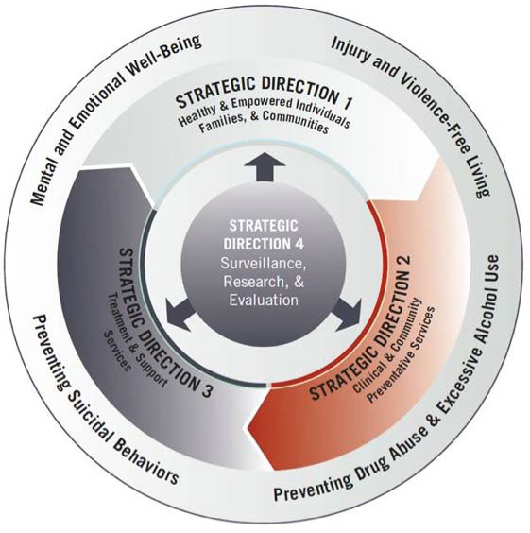
National Strategy’s
Goals and Objectives
Promote healthy and empowered individuals, families, and communities (4 goals, 16 objectives);
Enhance clinical and community preventive services (3 goals, 12 objectives);
3. Promote timely treatment and support services (3 goals, 20 objectives);
4. Improve suicide prevention surveillance collection, research, and evaluation (3 goals, 12 objectives).
Notes:
The National Strategy‘s goals and objectives fall within four strategic directions, which, when working together, may most effectively prevent suicides. This organization represents a slight change from the AIM (Awareness, Intervention, Methodology) framework adopted in the 2001 National Strategy:
1. Create supportive environments that promote healthy and empowered individuals, families, and communities (4 goals, 16 objectives);
2. Enhance clinical and community preventive services (3 goals, 12 objectives);
3. Promote the availability of timely treatment and support services (3 goals, 20 objectives); and
4. Improve suicide prevention surveillance collection, research, and evaluation (3 goals, 12 objectives).
Although some groups have higher rates of suicidal behaviors than others, the goals and objectives do not focus on specific populations or settings. Rather, they are meant to be adapted to meet the distinctive needs of each group, including new groups that may be identified in the future as being at an increased risk for suicidal behaviors.

Slide 9


Learn More
Suicide Prevention Resource Center
Promoting a public health approach to suicide prevention
edc.org
The nation’s only federally supported resource center devoted to advancing the National Strategy for Suicide Prevention.

Slide 10
Learn More
(Continue)
For additional information about the National Strategy for Suicide Prevention, visit:
http://www.surgeongeneral.gov/library/reports/national-strategy-suicide-prevention/index.html
http://www.samhsa.gov/nssp
http://www.actionallianceforsuicideprevention.org/NSSP

Slide 11

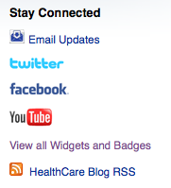
Resources
http://www.healthcare.gov
Social Networks
http://www.mentalhealth.gov
Suicide Prevention Lifeline
1-800-273-TALK (8255)
http://www.samhsa.gov
Notes:
It goes without saying open enrollment is less than a month away.
And to learn more about the law, the emphasis on preventative care, and about the new essential health benefits which includes, Mental health and substance use disorder services, including behavioral health treatment please go to healthcare.gov. You’ll find information and plenty of resources you can share with your friends and family.
Concluding comments:
Finally, in addition to national perspectives , and as the subtitle of today’s event suggests: Thinking Globally and Acting Locally - today we have the opportunity to hear of some of the great work that is happening across our Region II –
we will hear about State and community best and promising practices in suicide prevention for at-risk populations, and
Specialized training in Q, P, R - Question, Persuade, and Refer--an evidence-based tool for gatekeepers on the warning signs of suicide
It is also important to acknowledge the collaborative efforts that are taking place in suicide prevention in collaboration with federal, state and municipal government agencies, and community partners--schools, community-based health, mental health, and social services organizations, and faith-based organizations.
NYS has been a leader in suicide prevention programming, coalition building, training and technical assistance for many years—since the first Natl Strategy on Suicide Prevention. NJ has made great strides - on focused more recently on youth, something that is very import in light of .

Slide 12
Thank You
Dennis O. Romero, MA
Regional Administrator
Region II (NJ, NY, PR, VI))
Substance Abuse and Mental Health Services Administration (SAMHSA)
U.S. Department of Health and Human Services (HHS)
26 Federal Plaza, Suite 3337
New York, New York 10278
Phone: 212-264-8097 ♦ Fax: 212-264-2673
E-mail: dennis.romero@samhsa.hhs.gov
Website: www.samhsa.gov / 1-877-726-4727
Behavioral Health is Essential To Health • Prevention Works
Treatment is Effective • People Recover
Notes:
With that I thank you for your willingness to bear witness to this very important public health issue.
Thank you

